Slide 1
Does the Lord Ever Condemn Us?
How God Responds to Weakness
G. Breck Wightman, PhD
Notes:
I can remember the exact moment I realized I am a gospel perfectionist…
This feeling is not unique, Elder Holland recently shared this on social media:

Slide 2
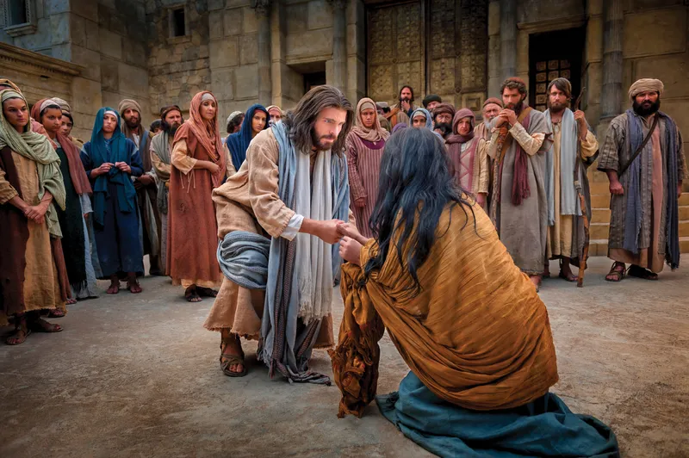
Notes:
Here was someone who was caught in the act of a grevious sin – one we are told in scripture is as grevious as can be. And yet, who did the Lord condemn? He chastised the hypocrites – because their desires were wrong. Even though this woman’s actions were wrong, I would suggest that he saw that for her, the Lord saw the sin was born of weakness, not out of rebellion. He extended mercy to her. I have had the blessing of sitting in church councils working with individuals who have made similar mistakes, and I can attest that the Lord sees weakness different than rebellion. For those who make mistakes out of weakness, the Lord tells us to go and sin no more. There is no punishment, only help to make you stronger.
That of course is the goal. In summary, the purpose of mortality is, in my mind, two stages: 1) getting our desires right (wanting to do accept the Lord and acknowledging we need Him) and then 2) spending the rest of our lives trying to become stronger and stronger in our ability to consistently act in accordance with those desires. President Worthen, our former BYU president stated this well:

Slide 3
Overview
What is sin?
What are the types of sin?
How does God respond to each type of sin?
How will God respond to ME?

Slide 4
What is sin?

Slide 5
1. There must be a law.
“Where no law is, there is no transgression” (Romans 4:15,
“If ye shall say there is no law, ye shall say there is no sin” (2 Nephi 2:5)
Notes:
The first baseline has to do with accountability. We must know that an action is wrong in order for an action to be sin. This is why those under the age of 8 cannot sin. This is why the Lamanites were merely ”dwindling in unbelief”

Slide 6
2. We must have a knowledge of the law.
“Therefore to him that knoweth to do good, and doeth it not, to him it is sin.” (James 4:17)
Example: Little children cannot commit sin (Moroni 8:8, D&C 29:47)
Notes:
The first baseline has to do with accountability. We must know that an action is wrong in order for an action to be sin. This is why those under the age of 8 cannot sin. This is why the Lamanites were merely ”dwindling in unbelief”

Slide 7
There is no safety in ignorance.
“…[I]f we stick a finger in an electric light socket, we will receive the same shock, irrespective of our knowledge of electricity. I repeat, ignorance is expensive. Particularly is this true since the Lord has decreed, ‘It is impossible for a man to be saved in ignorance.’”
-Elder Hartman Rector, Jr.
Notes:
On the one hand, we can’t just stick our heads in the stand and not seek a knowledge of the law.

Slide 8
1 Corinthians 8:2
“And if any man think that he knoweth any thing, he knoweth nothing yet as he ought to know."

Slide 9
Elder Jeffrey R. Holland
Our Day Star Rising
If justice were to take its toll on Jeff Holland right now, he would be in deep trouble. But fortunately, even though Jeff has passed the beginning of his accountability at age eight, the Lord might say… "Jeff's accountability is still increasing. He is learning more. He is doing more. Let's withhold judgement and watch him for a while to see if he can merit more blessings." It's like the story of the wheat and the tares. Don't jump in too soon in judging people—including yourself. That the tares are there is unmistakable and undeniable. But in His love and mercy, the Lord is willing to say, "I will not exercise judgment now. Let's wait a little longer." This principle has been at work in my life personally and in all of our lives collectively. We are kept, protected, encircled, and loved until we can work out some of the silly, petty weaknesses in our lives. But work them out we must.
Notes:
On the other hand, no matter how much we think about the law, we are still children in an eternal sense and we must give ourselves some room to grow, just as the Savior does.

Slide 10
What are the types of sin?

Slide 11
Moroni 7:6-8
For behold, God hath said a man being evil cannot do that which is good; for if he offereth a gift, or prayeth unto God, except he shall do it with real intent it profiteth him nothing.
For behold, it is not counted unto him for righteousness.
For behold, if a man being evil giveth a gift, he doeth it grudgingly; wherefore it is counted unto him the same as if he had retained the gift; wherefore he is counted evil before God.

Slide 12
A Typology of Sin
Actions
 | Good | Bad
Good
Bad
Righteousness
Weakness
Intentions
Hypocrisy
Rebellion

Slide 13
Rebellion

Slide 14
Two Types (Elder Christofferson)
ACTIVE
Open opposition to God, His prophets, or local leaders. Fighting and seeking to tear down the church
PASSIVE
“I don’t need God and I don’t have to repent”
- Elder J. Devn Cornish
“Quiet quitting”

Slide 15
Mortal Consequences
Numbers 16: Korah and his company who rebelled against Moses and Aaron and were swallowed in the earth.
Laman and Lemuel: “Inasmuch as thy brethren shall rebel against thee, they shall be cut off from the presence of the Lord” and “in that day that they shall rebel against me, I will curse them even with a sore curse” (1 Nephi 2:21,23, emphasis added).
Notes:
Look at the anti-Christs and the

Slide 16
Eternal Consequences
Abinidi: “The Lord redeemeth none such that rebel against him and die in their sins” and those who “have willfully rebelled against God, that have known the commandments of God, and would not keep them, these are they that have no part in the first resurrection.” (Mosiah 15:26).
Joseph Fielding Smith: “Even the wicked of the earth …after they have paid the price of their sinning — for they must suffer the excruciating torment which sin will bring — shall at last come forth from the prison house, repentant and willing to bow the knee and acknowledge Christ, to receive some influence of the Spirit of God in the telestial kingdom.

Slide 17
Sons of Perdition
Those “who have known the power of God in this mortal life and then, having full knowledge of the power and purposes of God, rebel against him, putting Jesus Christ to open shame.” (Joseph Fielding Smith, see also Hebrews 6:4-6)
So rare, it’s not even worth consideration
(President Oaks, October 2023 general conference)

Slide 18
Hypocrisy

Slide 19
Levels of Hypocrisy
Not every one that saith unto me, Lord, Lord, shall enter into the kingdom of heaven; but he that doeth the will of my Father which is in heaven.
Many will say to me in that day, Lord, Lord, have we not prophesied in thy name? and in thy name have cast out devils? and in thy name done many wonderful works?
And then will I profess unto them, I never knew you: depart from me, ye that work iniquity. (Matthew 7:21-23)

Slide 20
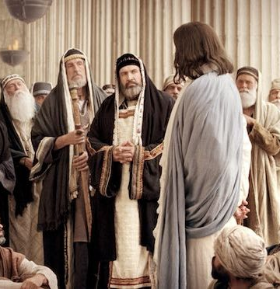
Consequences Matthew 23
Eight woes
House would be left desolate (destruction)
“How can ye escape the damnation of hell?
Will receive “greater damnation” than ”the publicans and harlots [who] go into the kingdom of God before you”

Slide 21
Matthew 7:15, 3 Ne 14:15
15 Beware of false prophets which come to you in sheep’s clothing, but inwardly they are ravening wolves.
16 Ye shall know them by their fruits.

Slide 22
Luke 12:1-2
1 Beware ye of the leaven of the Pharisees, which is hypocrisy.
2 For there is nothing covered, that shall not be revealed; neither hid, that shall not be known.
3 Therefore whatsoever ye have spoken in darkness shall be heard in the light; and that which ye have spoken in the ear in closets shall be proclaimed upon the housetops.

Slide 23
D&C 50:8
8 But the hypocrites shall be detected and shall be cut off, either in life or in death, even as I will…

Slide 24
Weakness

Slide 25
Romans 7:18-19
18 For I know that in me (that is, in my flesh,) dwelleth no good thing: for to will is present with me; but how to perform that which is good I find not.
19 For the good that I would I do not: but the evil which I would not, that I do.

Slide 26
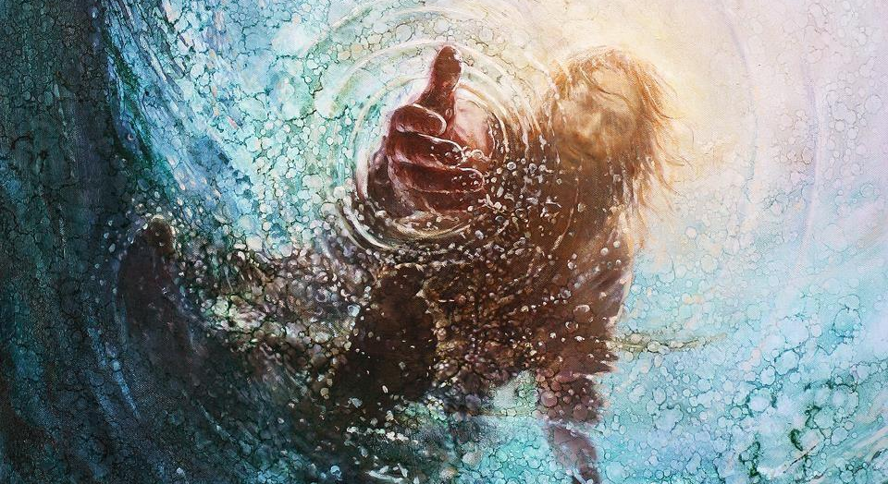

Slide 27
Matthew 26:41
41 …the spirit indeed is willing, but the flesh is weak.

Slide 28
Destiny Yarbro – 2020 Ensign Article
I’ve found that Satan uses addiction as “proof” that we inherently desire evil, that we are doomed from the start, or that the Lord has given up on us. The devil uses shame to discourage us, pointing out that no matter how many times we repent, the temptations continue to pop up.
There are many reasons why people are prone to addiction, but addiction often begins with an attempt to satisfy “deep and unmet needs.” So while rebellion can lead to addiction and addictions can cause sin, they are often sown in or magnified in weakness rather than willful rebellion.

Slide 29
Notes:
Here was someone who was caught in the act of a grevious sin – one we are told in scripture is as grevious as can be. And yet, who did the Lord condemn? He chastised the hypocrites – because their desires were wrong. Even though this woman’s actions were wrong, I would suggest that he saw that for her, the Lord saw the sin was born of weakness, not out of rebellion. He extended mercy to her. I have had the blessing of sitting in church councils working with individuals who have made similar mistakes, and I can attest that the Lord sees weakness different than rebellion. For those who make mistakes out of weakness, the Lord tells us to go and sin no more. There is no punishment, only help to make you stronger.
That of course is the goal. In summary, the purpose of mortality is, in my mind, two stages: 1) getting our desires right (wanting to do accept the Lord and acknowledging we need Him) and then 2) spending the rest of our lives trying to become stronger and stronger in our ability to consistently act in accordance with those desires. President Worthen, our former BYU president stated this well:

Slide 30
Elder Richard G. Scott
“The joyful news for anyone who desires to be rid of the consequences of past poor choices is that the Lord sees weaknesses differently than He does rebellion. Whereas the Lord warns that unrepented rebellion will bring punishment,​​​​ when the Lord speaks of weaknesses, it is always with mercy.”

Slide 31
Two Areas of Proof
Scriptures
Church membership councils

Slide 32
Elder Bruce C. Hafen
“The person most in need of understanding the Savior's mercy is probably one who has worked himself to exhaustion in a sincere effort to repent, but who still believes his estrangement from God is permanent and hopeless.”

Slide 33
Sister Rebecca L. Craven
“We should never question that in His mercy, the Lord is ready, willing, and anxious to help us overcome our weaknesses.”

Slide 34
Righteousness

Slide 35
Alma 41:3
And it is requisite with the justice of God that men should be judged according to their works; and if their works were good in this life, and the desires of their hearts were good, that they should also, at the last day, be restored unto that which is good (emphasis added).

Slide 36
Kevin J. Worthen
Through an iterative process, desire and action can ultimately merge into one harmonious whole where there is no gap between our desire to do something and its actual accomplishment… There is no gap between desire and action in a celestial being. This wholeness or integrity changes our very nature. Those abiding by a celestial law abide that law not because it is a requirement but because that is what they desire to do—that is who they have become.

Slide 37
A Typology of Sin
Actions
 | Good | Bad
Good
Bad
Righteousness
Weakness
Intentions
Hypocrisy
Rebellion
Notes:
I would suggest that the most crucial part of repentance is moving from bad to good DESIRES. Once we achieve that, we have a lifetime to keep working on moving from bad to good actions (think back to Truth #1).

Slide 38
D&C 97:8
“Verily I say unto you, all among them who know their hearts are honest, and are broken, and their spirits contrite, and are willing to observe their covenants by sacrifice—yea, every sacrifice which I, the Lord, shall command—they are accepted of me” (emphasis added)

Slide 39
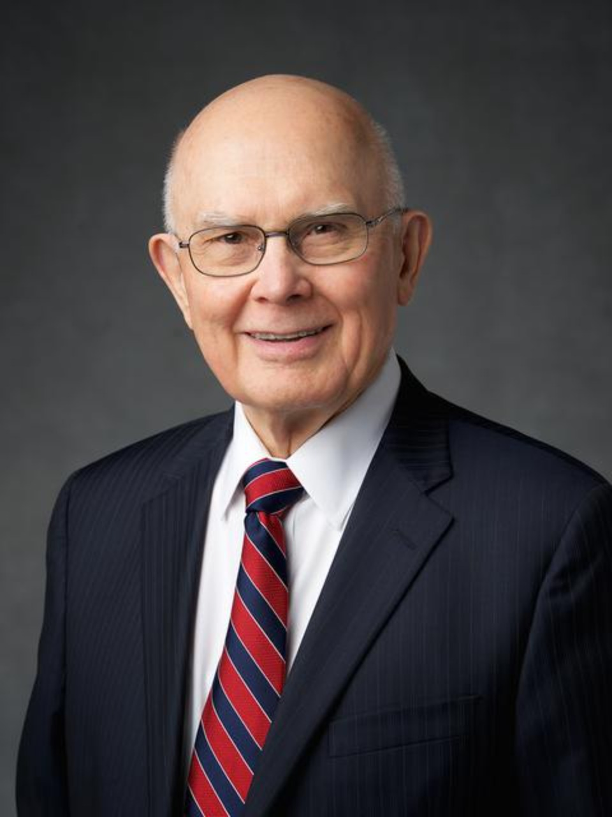
President Dallin H. Oaks
It is significant that when we partake of the sacrament we do not witness that we take upon us the name of Jesus Christ. We witness that we are willing to do so. The fact that we only witness to our willingness suggests that something else must happen before we actually take upon us that sacred name in the most important sense.

Slide 40
President D. Todd Christofferson
“With faith in Christ, we can pray that the Holy Spirit will effect a mighty change in us to instill these same divine motivations in our heart and help us practice the attributes of a Christlike character.”
The Character of Christ, April 2026 general conference

Slide 41
President D. Todd Christofferson
“With faith in Christ, we can pray that the Holy Spirit will effect a mighty change in us to instill these same divine motivations in our heart and help us practice the attributes of a Christlike character.”
The Character of Christ, April 2026 general conference

Slide 42
President D. Todd Christofferson
“With faith in Christ, we can pray that the Holy Spirit will effect a mighty change in us to instill these same divine motivations in our heart and help us practice the attributes of a Christlike character.”
The Character of Christ, April 2026 general conference

Slide 43
2 Corinthians 12:9
“…My grace is sufficient for thee: for my strength is made perfect in weakness…”
Notes:
End with testimony
I know that God designed a perfect plan that allows us to learn from sin, without being condemned by it, if we bind ourselves to the Savior.
I know that God sees your and my weakness differently than he does hypocrisy or rebellion. I know he will extend every mercy if we will remain humble, contrite, and have a desire to do good.
I know that God will save all the works of his hands. I know that He is a loving God who will give us all that he has. To the weak but willing, he will make them stronger. But even to the rebellious, he will save them at whatever portion they desire.

